Slide 1
The effect of the OCR
Understanding Your Financial World
Fin-Ed Centre

Slide 2
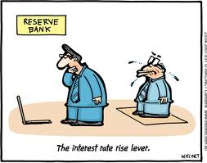
OCR is raised
Retail interest rates rise
Exchange rate appreciates (rises)
Less borrowing
Increased saving
Lower export returns
Lower import prices
Inflationary expectations fall
Overall weaker demand in the economy
Lower exporter incomes
Prices fall
Less inflation
Adapted from Williamson, M. (2008). Year 12 Economics Study Guide, 3rd ed. Auckland, New Zealand: ESA Publications (NZ)

